Slide 1

Neuromorphic Computing Paper Review
Dave Cheng
2/20/2018

Slide 2
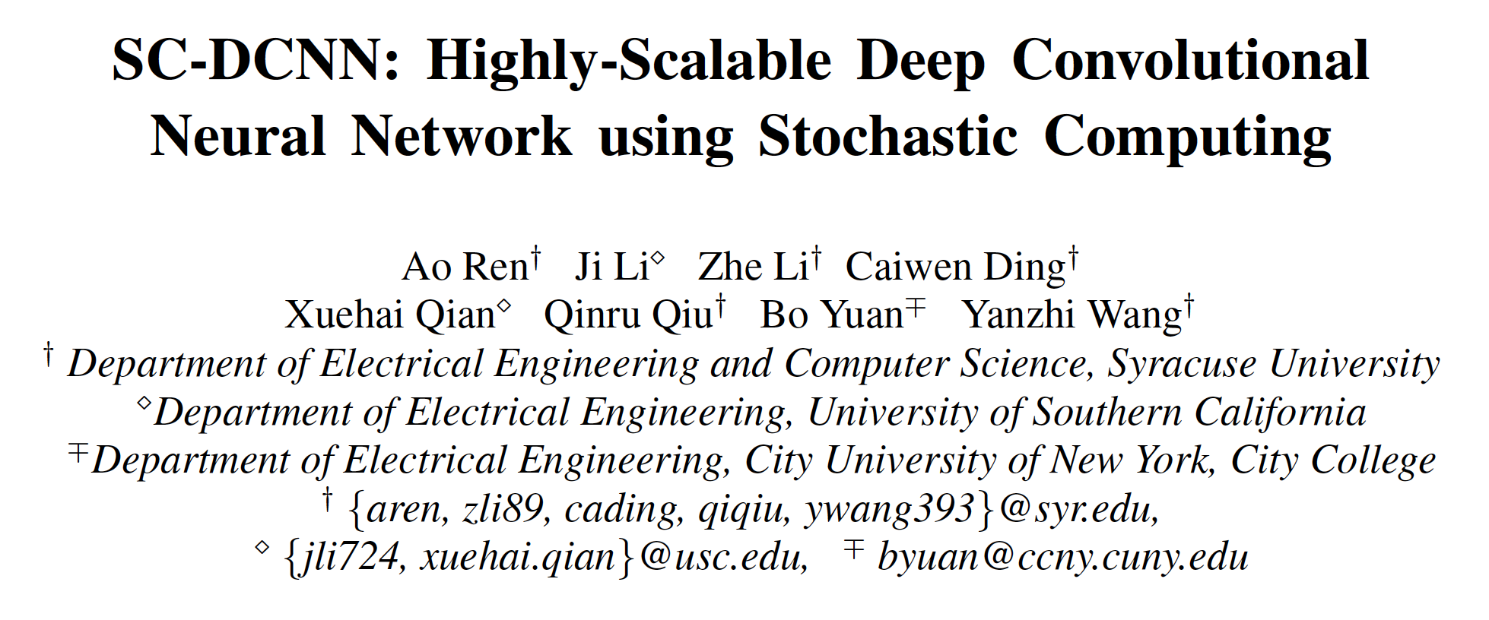
Papers about Stochastic Computing

Slide 3
Preliminary
What is the basic concept of Stochastic Computing (SC)?
SC is a paradigm that represents a probabilistic number by counting the number of ones in a bit-stream.
Consider this bit-stream 0100110100 ->4 1s out of 10 bits. 4/10 = 0.4
We use the above bit-stream to represent the number between [0,1]
Question1: How many 1s do we need to represent 0.4 in the range of [-1, 1]?

Slide 4
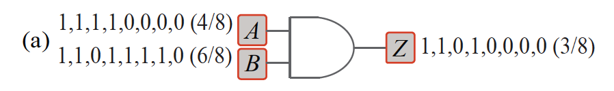
Research Motivation
SC-DCNN: Stochastic Computing + Deep Convolutional Neural Network
High scalability and ultra-low hardware footprint
0100110100 = 01100
Conventional multiplier
SC multiplier
Notes:
What the problem that the author tries to solve

Slide 5
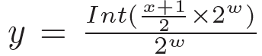
Technical contributions
Applying SC to DCNNs
Hardware oriented design.
Weight storage
proposed a Approximate parallel counter (APC)-based method for basic operation.
Question 2:
00100101
11001010
11101111
3/8
10011000
11001010
3/8
or
4/8
or
4/8
7/8
11011010 5/8
rescale to make sure very few 1’s in the bit-streams

Slide 6
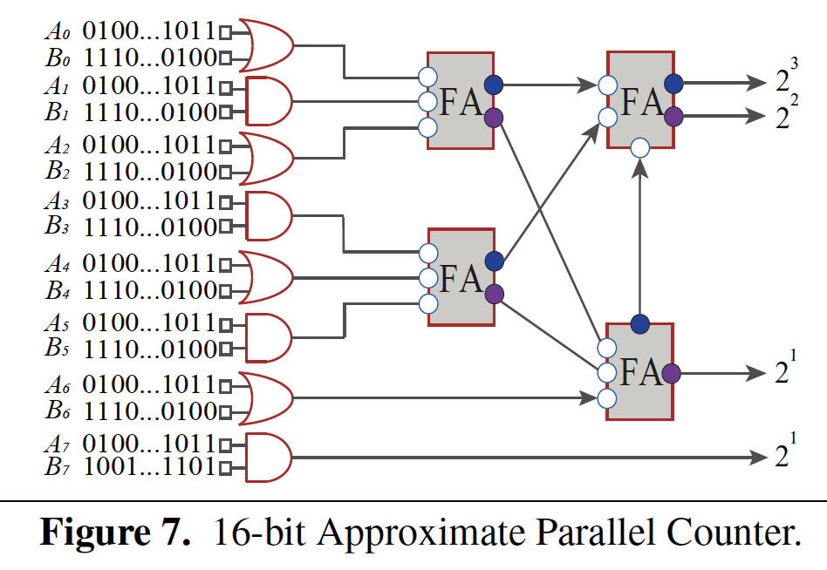
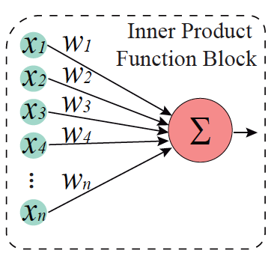
Technical contributions
APC-based inner product
number of inputs is n. length of a bit-stream is m
the products of x’s and w’s can be represented by a bit-matrix of size [n, m] .
count the number of ones in each column and represent the result in the binary format.
40% reduction of gatecount.
Notes:
Log2 16
log2n m.

Slide 7
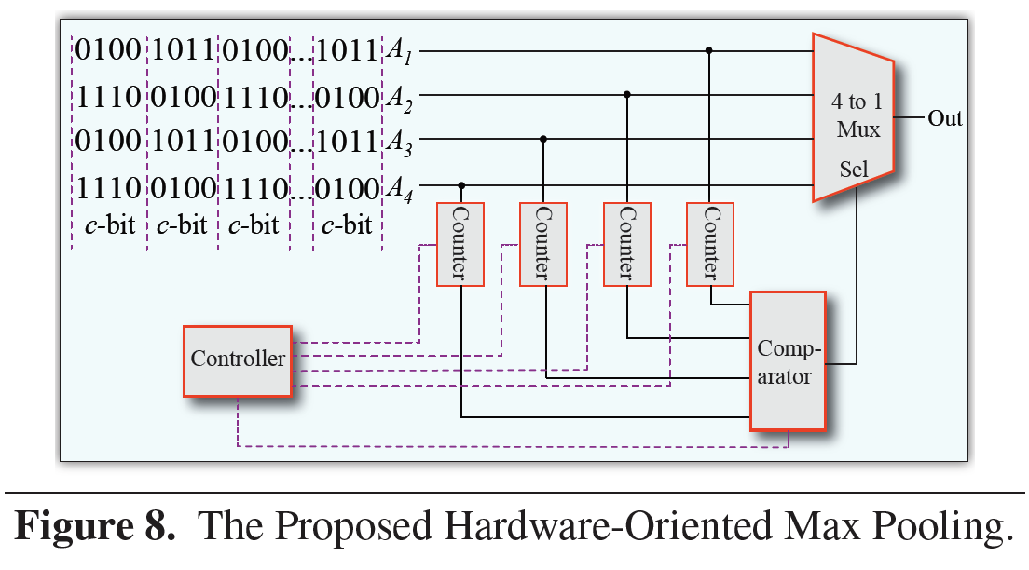
Technical contributions
Avg pooling causes more information loss than the hardware-oriented max pooling.
the fractional part of the number after average pooling is dropped
Ex: mean (2, 3, 4, 5) = 3.5 = 3 (binary)
Question3: What method will you propose?

Slide 8
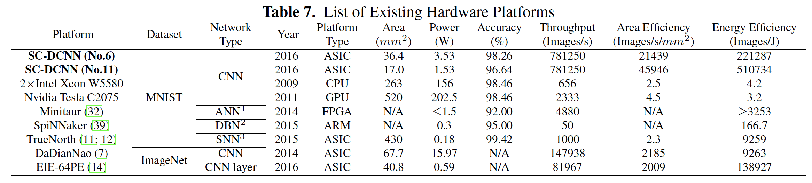
Experimental Results
Save storage from weight, inner product.
ASIC:Image/sec/area or Image/sec/watt
GPU: Image/sec

Slide 9
Q&A
Thank you for listening!

